Slide 1
4th European Network for Social and Emotional Competence (ENSEC)
University of Zagreb- Faculty of Teacher Education.
Promoting Resilience in Primary Schools
Good Practice from Europe
Carmel Cefai and Paul Bartolo, University of Malta
Anastassios Matsopoulos and Mariza Gavogiannaki, University of Crete, Greece
Assunta Zanetti, Roberta Renati and Valeria Cavioni, University of Pavia, Italy
Renata Miljevic-Ridicki, Tea Pavin Ivanec and Marija Saric, University of Zagreb, Croatia
Birgitta Kimber and Charli Eriksson, Orebro University, Sweden
Celeste Simões and Paula Lebre, University of Lisbon, Portugal

Slide 2
RESCUR: Optional Resilience Curriculum
The optional units are intended to offer choice to individual partner countries allowing them to address the perceived needs related to risk and resilience in particular contexts
It will make use of existing partner strengths and needs in these key areas but related to risk and resilience, and is expected to lead to more innovative, European-character product as a result of the trans-European collaboration

Slide 3
Optional Resilience Curriculum
Poorer socio-economic backgrounds
MIGRANTS
ROMA
Early school leaving
SEN
Notes:
Some groups in society are especially affected by early school leaving, particularly those from poorer socio-economic backgrounds and vulnerable groups, such as persons with physical and mental disabilities or other special educational needs
As young people with a migrant origin are often concentrated in lower socioeconomic groups, their average rate of early school leaving is double that of native youth
The rate is even higher for Roma populations, who tend to be among the most socially excluded members of society

Slide 4
Optional Resilience Curriculum
ROMA
Protective factors
Lack
Risk
factors
Limited Learning
Opportunities
Discrimination
Weaker Family Suuport
Protective factors
Risk
factors
Weaker Family Suuport
SEN
Discrimination
Lack
Limited Learning
Opportunities
MIGRANTS
Notes:
Such groups tend to suffer from weaker family support from their families, face discrimination within the education system and have more limited access to non-formal and in-formal learning opportunities outside compulsory schooling

Slide 5
EC(2012). Discrimination in EU in 2012. Special Eurobarometer 393.
In http://ec.europa.eu/public_opinion/archives/eb_special_399_380_en.htm#393

Slide 6
Optional Resilience Curriculum: Main Areas
Risk
Social Disadvantage & Diversity
Disability
Special Educational Needs
Gifted Children
Roma
Minorities & Migrants
Refugees

Slide 7
ROMA: Why a Resilience Program?
Largest, most impoverished, most vulnerable minority in C&E Europe
Stereotypes (e.g. Inferior and Dangerous)
Discrimination/Exclusion (Social, Political, Economic, Geographic)
Limited access to health care services
Heavily dependent on state welfare
Limited education
Low levels of skills for labour market
UNICEF (2005). Excluded and invisible: The state of world’s children 2006.
In www.unicef.org/sowc06/pdfs/sowc06_fullreport.pdf

Slide 8
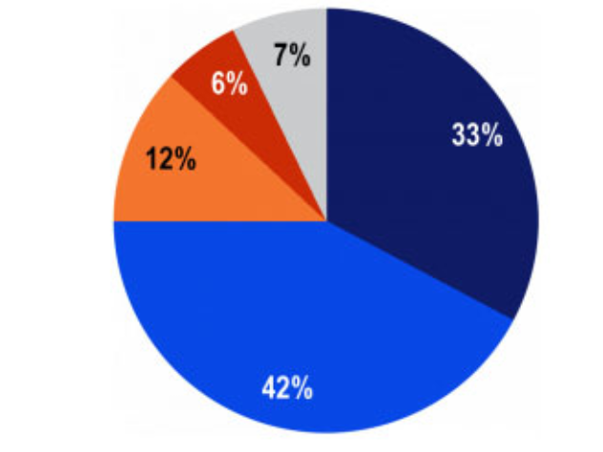
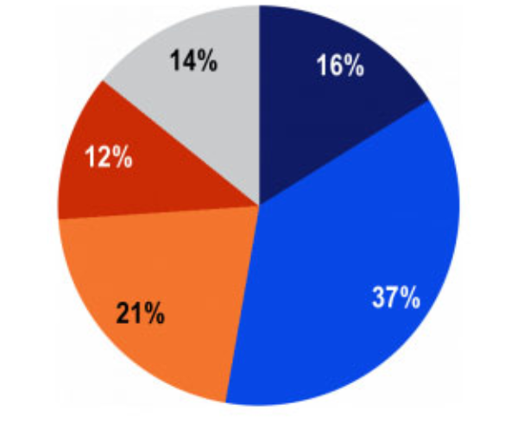
The Roma are a group of people at risk of discrimination
Society could benefit from a better integration of the Roma
EC(2012). Discrimination in EU in 2012. Special Eurobarometer 393.
In http://ec.europa.eu/public_opinion/archives/eb_special_399_380_en.htm#393

Slide 9
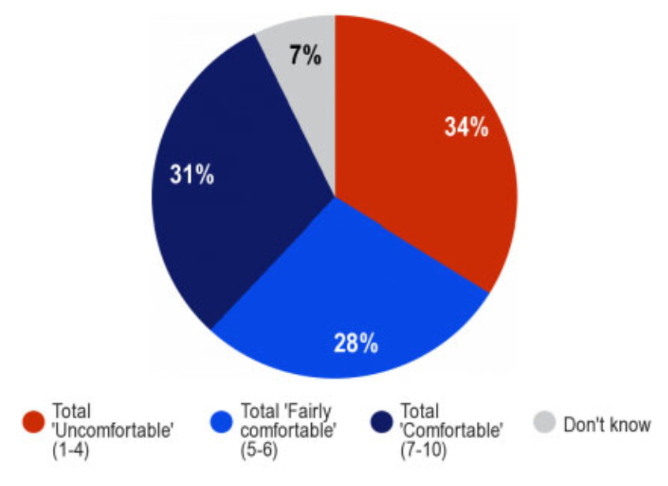
How citizens would feel about their children having Roma schoolmates?
EC(2012). Discrimination in EU in 2012. Special Eurobarometer 393.
In http://ec.europa.eu/public_opinion/archives/eb_special_399_380_en.htm#393

Slide 10
ROMA: Factors for early school leaving
Early exposure to racism and bullying
Social and cultural isolation
Conflicts with teachers or peers
Perceived lack of support in accessing the curriculum
Low teacher expectations in relation to attendance and achievement
Foster & Norton (2012)

Slide 11
ROMA: Focus on…
Promote educational equality
Promote resilience assets for positive development and active citizenship
Reduce school absenteeism and early leaving (Dimakos & Papakonstantinopolou, 2012)
“We feel that one of the main problems that we, as Gypsy women, face, is low self-esteem. There is an urgent need to strengthen our awareness of our own value and of our ability to resolve our own problems.
There is no doubt that self-awareness would lift our social, educational, political and cultural awareness. It would also lead to our undertaking social and educational action ourselves.”
Romnea/Gypsy women’s manifesto, Seville, May, 1994

Slide 12
REFUGEES: Why a Resilience Program?
Living in poor conditions
Denied access to education, protection and health-care services
Children are at a greater risk of abuse, neglect, violence, exploitation, trafficking or forced military recruitment
They may also have witnessed or experienced violent acts and/or been separated from their families
UNICEF (2005). Excluded and invisible: The state of world’s children 2006.
In www.unicef.org/sowc06/pdfs/sowc06_fullreport.pdf
UNHRC (2007). Through the eyes of a child: refugee children speak about violence. In http://www.unhcr.org/47c804682.html

Slide 13
REFUGEES: Barriers to resilience manifestations
Language, racism, labelling the trauma story (Hutchinson, Dorsett, 2012)
“We need to get rid of that thinking that our people are traumatised.
We are traumatised, yes. This is true and that’s fine.
But that does not mean what we are.
We are something different and we can provide.
We can offer. We can contribute”
(Marlowe, 2009, cit. in Hutchinson, Dorsett, 2012)

Slide 14
REFUGEES: Focus on…
Internal resources are one of the major contribution to refugee resilience
Optimism, adaptability, perseverance, belief in inner strength, positive attitude, hope in the future, locus of control, sense of coherence and purpose, high academic expectations (Hutchinson & Dorsett, 2012; FØrde, 2007)
External resources
Friends, parents, school (extracurricular activities, sports, teachers) (McEwen, 2007)
Children stressed the need for more information to enable them to protect themselves, especially since many do not come from violent environments and have developed few coping mechanisms (UNHRC, 2007).
Notes:
Refugee resilience – adapt often in completely unfamiliar environmnents (APA, 2010. Resilience and recovery after war: Refugee children and families in United States)

Slide 15
Disability: Why a Resilience Program?
Attitudinal and structural barriers
Discrimination, compromised participation, social exclusion
Disability-related risks and experiences that increases the likelihood of negative outcomes (King et al. 2003)
Refer more frequently suffer negative life events, compared to their mainstream peers (Simões, Matos, Tomé, et al., 2009)
victims of bullying or being rejected by classmates
Perceive their school performance to be lower than average
More pressed with homework
Feel more frequently unhappy, lonelier and sadder

Slide 16
Disability: The autism case
Systematic review (Lebre, Simões, Matos, Gonçalves, Teixeira et al., 2013)
Research on resilience and autism is at a relatively early stage
The majority of papers were concerned with resilience in family members (mothers)
Other related concepts (stress, QOL, mental health, stress, coping, communication, social skills)
Further studies could focus interventions for individuals with ASDs, their families in contexts such as schools in order to better understand how to promote the ability to cope and overcome adversity in children with ASDs and their families

Slide 17
Disability: Focus on…
Promote internal and external assets to cope with challenges and adversities (Benard, 1999; Wehmeyer & Schalock, 2001; Simões et al., 2009)
Self-determination
Self-awareness
Cooperation and communication
Empathy
Problem solving
Self-efficacy
Goals and aspirations
Caring relationships, high expectations,
meaningful participation
Home, school, peers & community
QoL
Self-efficacy x NLE
Problem Solving x NLE

Slide 18
Gifted: Why a Resilience Program?
Resilience
Vulnerability
Higher academic expectations and outcomes
Many cases of underachievement
Disorganization, lack of concentration, perfectionism, low self-esteem, unwillingness to conform, anxiety, vulnerability to peer pressure, external locus of control
(Ford, 1993, Kline & short, 1999)
Depends on:
Type of giftedness
Educational fit
Personal characteristics
(Neihart, 1999)
Notes:
Emprical and theoretical for both positions: incresse resilience and increase vulnerability

Slide 19
Gifted
Educational situations that heighten their risk for adjustment problems (Pheiffer & Stocking, 2000; Neihart, 2011)
limited access to others with similar interests, ability, and drive
not sufficiently challenged
differences in their abilities and their heightened sensitivities
Early years (Gross, 1999):
Misidentification, inappropriate grade-placement, inadequate curriculum
Early awareness of differences between them and their peers
Attempts to conceal their ability for peer acceptance
Notes:
Gifted children are often in educational situations that heighten their risk for adjustment problems (Pheiffer & Stocking, 2000; Neihart, 2011)
Many Gifted students suffer from painful, troubling and debilitationg psychologival problems (Pheiffer & Stocking, 2000)
We know that gifted kids often have very high standards for themselves which some refer to as perfectionism. We also know that gifted kids expect to be strong in all areas of their performance and functioning as they are in their strength area, which is often very unrealistic. Neihart (2011)

Slide 20
Gifted: Focus on…
Reduce risk of maladjustment strengthening factors that enhance positive outcomes (Reis, Colbert, Hébert, 2005)
Believe in self
Personal characteristics (sensitivity, independence, determination to succeed, appreciation of cultural diversity, inner will)
Problem solving skills
Support systems
Participation in special programs
Set and adjust learning goals (King, 2004)
Notes:
We know that gifted kids often have very high standards for themselves which some refer to as perfectionism. We also know that gifted kids expect to be strong in all areas of their performance and functioning as they are in their strength area, which is often very unrealistic. Neihart (2011)
Many Gifted students suffer from painful, troubling and debilitationg psychologival problems (Pheiffer & Stocking, 2000)

Slide 21
Optional Resilience Curriculum: Main Areas
Disability
Greece (OC) / Portugal (CF)
Optional Curriculum
Italy (OC)
Portugal (CF)
Gifted Children
Italy (OC) / Malta (CF)
Roma
Croatia (OC) / Portugal (CF)
Refugees
Malta (OC) / Sweden (CF)

Slide 22
Optional Resilience Curriculum: Key Principles
Infused in the other content areas of the curriculum as well as in pedagogy, relationships and classroom management
Integrated in the mainstream curriculum rather than a bolt on, added activity delivered by outside experts
Complement and build on the universal framework, reflecting and responding to the social and economic realities and needs of particular partner countries or regions
Developmental and inclusive, being flexible and responsive to the needs of the individual learner differences, underlining the right of all learners for a quality resilience education and a commitment towards social justice with awareness of the risk for discriminatory practices due to individual educational needs, minority statuses, and poverty
Spiral approach, with identified key themes straddling across the early and primary school years
Formatively assessed by both the classroom teacher and the students themselves
Search for state-of-the-art service arrangements reflecting the EU agenda for excellence and competitiveness at the global level
Seek to the enhancement of ethical standards through reflective practice

Slide 23
Optional Resilience Curriculum: Manual
Theoretical Framework
Principles
Learning outcomes
Structure
Content areas
Assessment modes of two major areas

