Slide 1
Prof. M.A. Zanetti
Dr. V. Cavioni
Dept. Of Brain and Behavioral Sciences
University of Pavia, Italy
Referenti progetto:

Slide 2
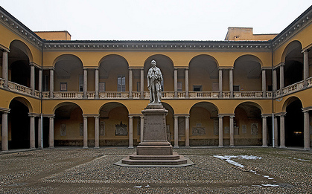
UNIVERSITY OF PAVIA
Founded in 1361
Department of Psychology -Faculty of Letters and Philosophy (1962).
Department of Brain and Behavioral Sciences (2013) developmental, clinical, experimental and work psychology and neuroscience

Slide 3
RESEARCH ACTIVITY
Italian Lab on Research and Development of Giftedness
Network of schools: training teachers and school staff, programs for children, meetings with parents
Research and conferences: social and emotional wellbeing, resilience, giftedness, vocational guidance

Slide 4
PROJECTS
National project: PRIN
Eu project: EAR, SHARP, PROM
INVALSI: assessment early achievement

Slide 5
ITALIAN TEAM
Prof. Maria Assunta Zanetti
Dr. Valeria Cavioni
Dr. Roberta Renati
Graduate trainees for the training of teachers and implementation of the pilot project

Slide 6
Italian team role
Participation in all consortium meetings, skype session and training of trainers workshop
Contribution to the theoretical framework of RESCUR and the planning of the activities, including resources and handouts
Writing theme 5 and one subtheme from theme 6 of the curriculum
Writing of theme 5 for the parents manual
Critical friend of Malta for curriculum theme and parents’ manual
Organizing the pilot project in Italy, including training of teachers, implementation, evaluation and writing of report for whole group
Translation of all documents, including website, flyer, teachers’ manuals, parents’ manuals, etc in Italian
Dissemination activities in Italy and internationally

Slide 7
SCHEDULE
Theoretical Framework themes and subthemes
Writing activities
Training of traners
*Training of Teachers
*Piloting
*Evaluation
Final version of the manual

Slide 8
THEMES
Developing a positive mindset
Building on strengths
Developing self-determination
Enhancing communication skills
BUILDING HEALTHY RELATIONSHIPS
Turning challenges into opportunities
(subtheme: Transition and changes)

Slide 9
BUILDING HEALTHY RELATIONSHIPS
SUBTHEME 1
ESTABLISHING AND MAINTAINING HEALTHY RELATIONSHIPS
Set 1
Making and having friends
Set 2
Seeking and providing support
Set 3
Nurturing relationships and school climate
SUBTHEME 2
DEVELOPING COOPERATION SKILLS AND EMPATHY AND ENGAGING IN RESPONSIBLE AND ETHICAL BEHAVIORS
Set 1
Sharing, cooperation and teamwork
Set 2
Developing empathy
Set 3
Ethical, responsible and moral behavior

Slide 10
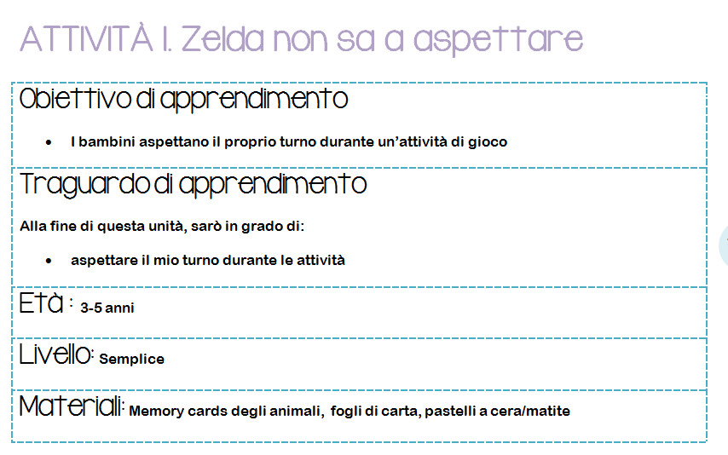
EXAMPLE ACTIVITY

Slide 11
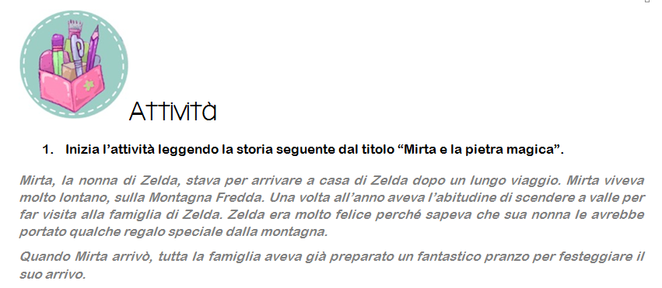
EXAMPLE ACTIVITY

Slide 12
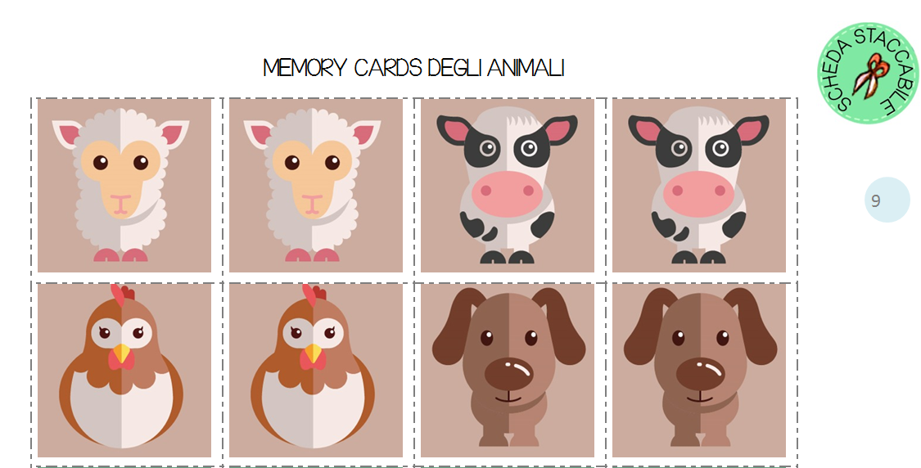
EXAMPLE ACTIVITY

Slide 13
TRAINING OF TEACHERS
12 schools («Istituti Comprensivi»)
29 teachers from the provinces of Pavia and Milan
5 kindergarten + 24 primary teachers
Agenda
Wednesday 10/09
Saturday 4/10
Friday 10/10
Wednesday 29/10
Wednesday 5/11
Friday 5/12

Slide 14
DISSEMINATION
Translation of the Italian version of the RESCUR website
Translation of RESCUR flyer in Italian
Posters and flyer to schools
RESCUR link University website
ENSEC symposium in Zagreb 2013
Paper in the Croation Journal of Education
ENSEC symposium in Lisbon 2015
Paper on multiculturalism and resilience in UK journal
Other EU projects
Paper at European Conference of Psychology, Milan 2015

Slide 15
NEXT STEPS
Writing Parents’ manual (theme 4)
Design and formatting of the final international version of the Teachers’ and Parents’ manuals
Training of teachers in Italy
Implementation of pilot activities in schools
Evaluation and report (in English) of evaluation
Translation of all manuals in Italian
Organising the next consortium meeting in Pavia in March 2015
A half day seminar on RESCUR in Italy (2015)

Slide 16
THANK YOU
zanetti@unipv.it
rescur.italy@gmail.com

