Slide 1


Promoting Resilience in Early Years &Primary School (RESCUR)
Training of Teachers
Malta September 2014

Slide 2
Learning outcomes
By the end of the training workshop, participants should be able to
  Define resilience and how it relates to positive academic and social and emotional outcomes
  Define growth mindset and how it relates to positive academic and social and emotional outcomes
  Implement growth mindset activities in their classroom on a weekly basis over a six week period
  Make use of the teacher and self assessment checklists
  Use the implementation index as a self monitoring tool
  Use pedagogical and management strategies to create a positive classroom climate
  Identify individual and school strategies to nurture their own resilience and wellbeing

Slide 3
Workshop Outline: RESCUR
Introducing RESCUR project
  Defining resilience
  Curriculum framework and principles
  Curriculum structure
  Curriculum content areas

Slide 4
Workshop Outline: Growth Mindset
  Overview of learning goals for positive growth mindset
  Activities for early years: overview, role play of activities and processing in relation to implementing the activities in the classroom
  Activities for early primary school: overview, role play of activities and processing in relation to implementing the activities in the classroom
  Activities for late primary school: overview, role play of activities and processing in relation to implementing the activities in the classroom

Slide 5
Workshop Outline: monitoring, assessment and evaluation
Use of teacher and self assessment checklists
Use of Implementation Index
Use of Teacher Tips handout for the creation of positive classroom climate
Nurturing teachers’ own health and resilience
Evaluation (prescribed form)

Slide 6
RESCUR Project
3 year EU LLP Comenius Project (2012-2015)
6 research partners:
  University of Malta, Malta (Coordinator)
  University of Crete, Greece
  University of Pavia, Italy
  University of Zagreb, Croatia
  Orebro University, Sweden
  University of Lisbon, Portugal

Slide 7
Objectives
RESCUR is aimed at developing a resilience curriculum for early and primary education in Europe through the intercultural and transnational collaboration among the partner institutions, tapping into the resources and expertise of the various partners involved.

Slide 8
What is resilience
Definition of resilience implies succesful adaptation in the face of adversity and environmental stressors:
  “Set of qualities that foster a process of successful adaptation and transformation despite risk and adversity” (Masten, 1994)

Slide 9
What is resilience
Risk: soci0-econonic disadvantage, individual educational needs, cultural mismatch, family instability, negative early experiences, eg. children living in poverty, Roma children, children from minority and refugee status, children with disability and gifted children
Success: academic success, social competence, emotional literacy

Slide 10
Three year programme
In the first year the consortium has developed a universal resilience curriculum for the early years and primary school education.
In the second year, the curriculum will be piloted in a number of schools in each country
In the third year the curriculum will be revised and published in soft and hard copies in the seven languages of the consortium.

Slide 11
Curriculum Principles
Spiral approach, with identified key themes straddling across the early and primary school years
Infused in the other content areas of the curriculum as well as in pedagogy, relationships and classroom management
European identity and diversity
Developmental and inclusive, being flexible and responsive to the needs of the individual learner differences, underlining the right of all learners for a quality resilience education and a commitment towards social justice with awareness of the risk for discriminatory practices due to individual educational needs, minority statuses, and poverty
Integrated in the mainstream curriculum rather than a bolt on, added activity delivered by outside experts
Evidence based
Formatively assessed by both the classroom teacher and the students themselves

Slide 12
Manuals
The curriculum will consist of 3 manuals for teachers complete with resources and activities centred around 6 major themes (spiral)
Manual 1: Early Years (3-5 years)
Manual 2: Early Primary Years (6-8 years)
Manual 3 : Late Primary Years (9-11 years)
There will also be a complementary manual for Parents

Slide 13

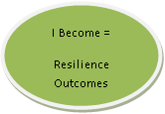

RESCUR Framework
STORYLINE
BEING DOING BECOMING
RESILIENCE CURRICULUM
DIRECT-Skills
(Taught)
INDIRECT-Processes
(Caught)
Child Wellbeing & Resilience

Slide 14
DIRECT-Skills
(Taught)
Resilience as
Specific Curriculum Area
Resilience as
Cross-Curricular Area

Slide 15
INDIRECT-Processes (Caught)
WHOLE
SCHOOL
CLASSROOM (Climate & Relationships,
Teacher Behaviour, Attitudes & Creativity)
FAMILY
COMMUNITY
Engagement
Whole School Policy
Engagement & Education
Teacher
Training
Family Resilience
INSET
Teacher Resilience

Slide 17
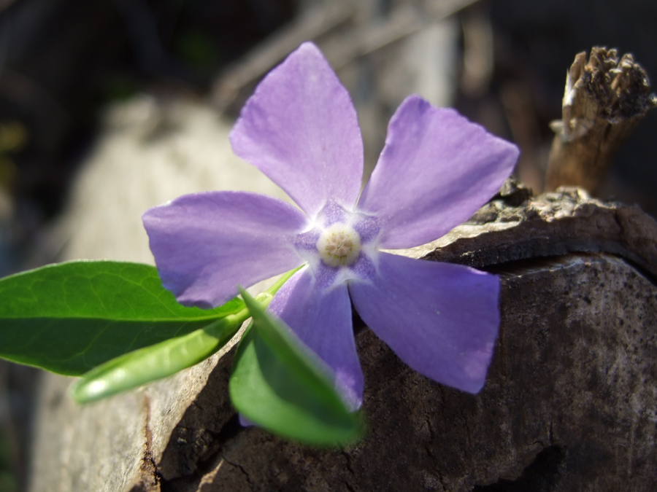
Six Themes of Resilience Curriculum
Developing a positive mindset
Building on strengths
Developing self-determination
Enhancing communication skills
Building healthy relationships
Turning challenges into opportunities (tough mindedness)

Slide 18

Theme 1: Developing Positive Mindset
Optimistic thinking and positive mindset when facing life’s adversities
  Appreciating & enjoying one’s positive emotions (including humour)

Slide 19
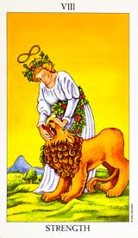
Theme 2: Building on Strengths
Positive self-concept and self-esteem
Awareness and use of strengths in academic and social engagement

Slide 20

Theme 3: Developing
Self-determination
Creative problem-solving and decision making
Empowerment: autonomy, self-efficacy, internal locus of control)

Slide 21
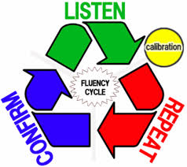
Theme 4: Enhancing communication skills
Interpersonal communication (effective listening skills, giving feedback communicating ideas )
Assertive behaviour

Slide 22
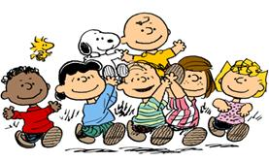
Theme 5: Building healthy relationships
Establishing & maintaining healthy and rewarding relationships
Engaging in ethical and responsible behavior

Slide 23
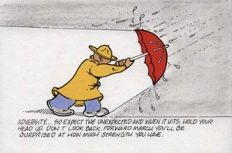
Theme 6: Turning challenges into opportunities (tough mindedness)
Developing courage in adversity and persistence in the face of failure, injustice, overcoming difficulties and setbacks (e.g. disability, sickness, discrimination)
Dealing with rejection by teachers, peers, family members and managing related negative emotions
Dealing with bullying behaviours in school
Dealing with obstacles such as family conflicts, divorce, poverty & parental unrealistic expectations
Dealing with change, loss & transitions in life

Slide 24
Structure
Three manuals: early years, early primary and late primary
Spiral curriculum, the same themes for all ages
Developmental/inclusive rather than age determined
In each group three different levels:
  Basic
  Intermediate
  Advanced (teacher decides which level)

Slide 25
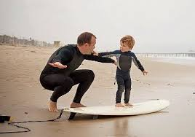
Principles
Eg. SAFE Approach
  Sequenced step-by-step training approach
  Active forms of learning
  Focus sufficient time on skill development
  Explicit learning goals

Slide 26
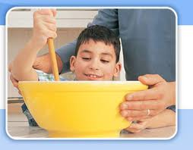
Parents’ Manual
Complementary to teachers’ manual
A guide for parents in building resilience in their own children
  a systemic perspective

Slide 27
Developing a Growth Mindset
1. Optimistic thinking and positive mindset when facing life’s adversities
  Dispositional optimism-good things will happen, confidence to persevere in adversity (Scheiner & Curver, 1992)
  Positive thinking/self-talk (promotes health, well-being & longevity (Seligman, 2011)

Slide 28
Developing a Growth Mindset
2. Using emotions to promote growth and wellbeing:
  Appreciating & enjoying one’s positive emotions (positive emotions & adaptive coping strategies important to satisfying life, protects against development of psychological problems (Compton, 2005)
  Humour (positive appraisal of life events-less stress, adds to psychological well-being, life satisfaction & self-esteem (Peterson, Ruch, Beerman, Park & Seligman, 2007)

Slide 29
Subthemes
Subtheme 1: Positive and Optimistic Thinking when facing Challenges
  Positive and Negative Thinking
  It’s good to think positive!
  Challenging Negative Thoughts
Subtheme 2: Using emotions to promote growth and wellbeing:
  Hope
  Happiness
  Humour

Slide 30
Learning goals: Positive and negative thinking
Early Years (3-5 years)
Recognize that we can either look at the sunny side or at the down side of life
Identify what sunny side thinkers and down side thinkers might say
Recognize and demonstrate how sunny side thinkers and down side thinkers might react to challenges

Slide 31
Learning goals: Positive and negative thinking
Early Primary (6-8 years)
Give examples of what sunny side thinkers and down side thinkers might say when encountering challenges
Identify and demonstrate upside thoughts and downside thoughts to setbacks
Break down an upside thought (Not Me/ Not Always/ Not Everything) and a downside thought into 3 parts (Me/ Always/ Everything)

Slide 32
Learning goals: Positive and negative thinking
Late Primary (9-11 years)
Break down an optimistic explanatory style (Not Me/ Not Always/ Not Everything) and a pessimistic explanatory style style (Me/ Always/ Everything) into 3 parts
Change a pessimistic explanatory style (Me/ Always/ Everything) into an optimistic explanatory style (Not Me/ Not Always/ Not Everything).
Describe a situation that includes a pessimistic explanatory style (Me/ Always/ Everything) and then change it into an optimistic explanatory style (Not Me/ Not Always/ Not Everything).

Slide 33
Learning goals: It’s good to think positive!
Early Years (3-5 years)
Recognize that sunny side thinking can help us feel better while down side thinking might make us feel worse
Recognize that upside and downside thinking can affect the way we feel and act
Change a downside thought into an upside thought

Slide 34
Learning goals: It’s good to think positive!
Early Primary (6-8 years)
Identify an upside or a downside thought to a setback, and
demonstrate the feelings and actions that might follow
Illustrate a thoughts → feelings → actions sequence
Recognize how thinking about an adversity can have consequences on feelings and actions, in an ABC flowchart
Late Primary (9-11 years)
Complete an ABC flowchart for a setback
Give an example of an ABC sequence
Produce their own ABC flowchart

Slide 35
Learning goals: Challenging Negative Thoughts
Early Years (3-5 years)
Take up the role of an object and give one reason why it is important
Mention one good thing they like about themselves
Practice talking back to their negative thoughts
Early Primary (6-8 years)
Recognize that when we encounter a setback, there are still things in our life that are good
Identify and list all the counter-evidence to dispute a downside thought
Distinguish between the best, worst and most realistic case scenario for a setback, and recognize that thinking of the worst case scenario can make us feel worse

Slide 36
Learning goals: Challenging Negative Thoughts
Late Primary (9-11 years)
Recognize that there are different ways of thinking about a problem
Identify alternative ways of thinking about a setback (Not Me/ Not Always/ Not everything)
Generate alternatives to their negative thoughts (Disputation), list the consequences these alternative thoughts bring (Energization), and add these to their ABC flowcharts

Slide 37
Learning goals: Using HOPE to promote growth and wellbeing
Early Years (3-5 years)
Recognize that bad times do not last forever
Recognize that bad times are usually followed by better times
Identify new goals to help make a bad time get better
Early Primary (6-8 years):
Practice remaining hopeful when trying to reach a goal
Practice remaining hopeful when making a plan on how to reach a goal
Practice remaining hopeful when their first attempt to reach a goal is unsuccessful

Slide 38
Learning goals: Using HOPE to promote growth and wellbeing
Late Primary (9-11 years):
Practice remaining hopeful during a setback
Experience and demonstrate a hopeful mindset when setting a personal goal
Experience and demonstrate a hopeful mindset when reflecting about the future

Slide 39
Learning goals: Using HAPPINESS to promote growth and wellbeing
Early Years (3-5 years):
Discuss their experience of happiness
Identify and discuss a time when they felt happy
Identify, illustrate, and discuss an activity or a person that makes them feel happy
Early Primary (6-8 years):
Recognize that bad feelings can be turned into good feelings
Identify, act out, and discuss different things we can do to turn a bad mood into a good mood
Apply the ‘flipping the feeling’ strategy to change bad feelings into good feelings

Slide 40
Learning goals: Using HAPPINESS to promote growth and wellbeing
Late Primary (9-11 years):
Discuss happiness and their experience of it
Apply the ‘flipping the feeling’ strategy to change bad feelings into good feelings
Identify and illustrate a person, place, object or event that makes them happy
Identify 3 things that make them happy and write down how they have contributed to them

Slide 41
Learning goals: Using HUMOUR to promote growth and wellbeing
Early Years (3-5 years):
Recognize that finding the funny bits in a problem help us feel better
Talk about what makes me laugh
Early Primary (6-8 years):
Identify and list the benefits of humour
Identify and write about what makes them laugh
Discuss what they can do to ensure humour is helpful and not harmful
Late Primary (9-11 years):
Identify and list the benefits of humour
Talk about what makes me laugh
Make a campaign about the do’s and don’ts of humour

Slide 42
Layout of activities
Topic of activity:
Age group: Early Years, Early Primary, Late Primary
Learning goal: Child will be able to…
Learning outcome: By the end of this activity, I will be able to…
Level: Basic/Intermediate/Advanced
Resources: Manual, sheet of paper
Activity Steps:
Extended activity:
Take home activity:

Slide 43
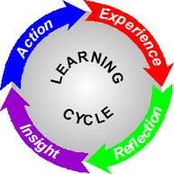
Activities Early Years
Role play and process two activities, one from each subtheme, from each year groups, making use of SAFE approach
Activity 1: Positive and Optimistic Thinking when facing Challenges (manual page…)
Activity 2: Using emotions to promote growth and wellbeing (manual page …)

Slide 44
Activities Early Primary (role play in group)
Activity 1: Positive and Optimistic Thinking when facing Challenges (manual page…)
Activity 2: Using emotions to promote growth and wellbeing (manual page …)

Slide 45
Activities Late Primary (role play in group)
Activity 1: Positive and Optimistic Thinking when facing Challenges (manual page…)
Activity 2: Using emotions to promote growth and wellbeing (manual page …)

Slide 46
Processing of activities
    How did you feel about this activity? What did you like/did not like?
    What was most helpful for you to learn in this activity?
    How relevant is this activity to the students in your classroom?
    How meaningful do you think your students will find this activity? Would you make any modifications? If yes, what and why?
    What challenges might there be in implementing the activity successfully with your students? How may these be overcome?

Slide 47
Assessment
Present the two assessment checklists, one for the teacher and one for the students (included in pack)
Ask participants to complete the teacher checklist either on their whole class from last year or on a particular student; then discuss in pairs/small groups
Ask participant to go over and discuss the student checklist in small groups
Discuss in whole group how the checklists maybe be completed by the classroom teacher and the students at the end of the pilot.

Slide 48
Implementation
Present the Implementation Index (included in the pack)
Ask participants to complete the index individually, ticking items where they have concerns, issues, difficulties with.
Ask participants to discuss in small groups.
Discuss in whole group how the index maybe be used by the teacher during the plan and monitor the implementation

Slide 49
Creating a positive classroom climate
Present the Teacher Tips Handout(included in pack)
Ask participants to go over the handout individually, ticking, identifying strengths and areas for intervention.
Ask participants to discuss in small groups.
Discuss in whole group how the teachers may create a positive classroom climate through their pedagogy, resources, activities, relationships and classroom management.

Slide 50
Nurturing teachers’ own resilience
Ask participants to discuss in small groups the following four issues:
  What are the main challenges/risks to teachers’ own wellbeing and health?
  Why is it important for the teacher to take care of own health and wellbeing besides those of the students?
  What can the classroom teacher do to protect own health and promote their wellbeing and resilience?
  What can the school do to support the teachers’ wellbeing and resilience
Discuss in whole group how the teachers themselves and the school as a community may support teachers’ wellbeing and resilience.
Refer teachers to the handouts on teachers’ resilience in the pack (Henderson and Milstein (2003); What makes a resilient teacher).

Slide 51
Evaluation
Each participant to fill in the evaluation form in the pack (enclosed).

