Slide 1
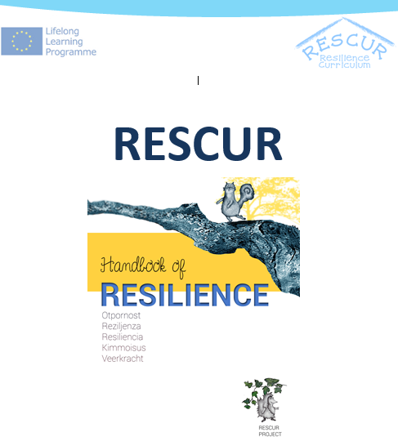
RESCUR PILOT
SELF-DETERMINATION THEME
Portugal

Slide 2
SELF-DETERMINATION THEME
Creative Problem Solving and Decision Making
    Topic 1: Defining the problem and generating creative solutions
    Topic 2: Evaluating the solutions and decision making
    Topic 3: Implementing and evaluating the solution
Empowerment/Autonomy
    Topic 1: Developing meaning in life and sense of purpose
    Topic 2: Fostering agency and self-efficacy
    Topic 3: Promoting self-advocacy

Slide 3
Where was the pilot implemented?
Four main settings:
Grouping of schools Dr. Azevedo Neves
(2) Grouping of schools Dr. Ruy Luis Gomes
(3) Santa Casa da Misericórdia de Almada
(Non-governmental organization)
(4) Casa das Cores
(Temporary shelter)
9 Schools/Kindergartens
25 Teachers/Educators
407 Pupils

Slide 4
Where was the pilot implemented?
Legend:
1-Training evaluation;
2- Assessment checklists (teacher/student);
3-Pilot implementation index;
4-Self-reflective diary;
5-focus group

Slide 5
Where was the pilot implemented?
Legend:
1-Training evaluation;
2- Assessment checklists (teacher/student);
3-Pilot implementation index;
4-Self-reflective diary;
5-focus group

Slide 6
Findings
PROCESS EVALUATION
RESULTS EVALUATION
teacher training and curriculum evaluation
implementation index
self-reflective diaries
focus groups with the teachers
assessment checklists
(teachers and pupils)
focus groups conducted with the children

Slide 7
Findings
Teachers Training
dynamics of the session, its contents, the support materials used in the sessions
have more time (explore more in deep the manual), training and pilot implementation simultaneously

Slide 8
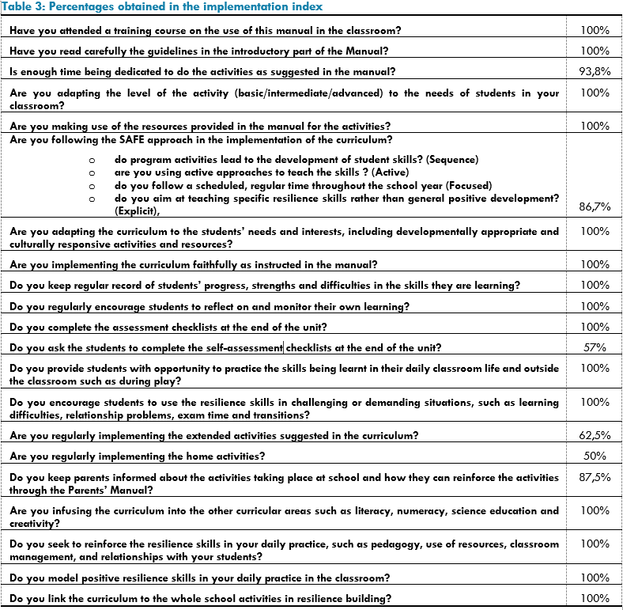
Findings
IMPLEMENTATION INDEX
Self-assessment Checklists
Extended activities
Home activities

Slide 9
Findings
Self-Reflective diaries
Topics that children revealed more interest:
  Mindfulness
  Reflexion in the class
  The activity following the story
  The stories

Slide 10
Findings
Focus groups (Teachers)
What didn’t go well?
• Lack of time to do all the activities planned in the manual
• Early years
• Parents involvement
• Assessment checklists
What went well?
• Children enjoyed the stories and the mascots
• Usually don’t have materials as detailed as the manual we provided
• the mindfulness
• Problem solving activities
• Some teachers were able to infuse the curriculum into the other curricular areas
• Some teachers found creative ways to promote the school-home communication
What did the children most liked in the sessions?
• The mindfulness activities
• The stories
• The mascots
What didn´t the children liked in the sessions?
• Nothing
Have you noticed any improvement in the students’ behavior during the pilot?
• Use the problem solving strategy - stop and think
• More attentive and quiet in the class
• Changes in the behavior
• Some concepts were acquired
• The ability to speak for themselves
• The spirit of the class as a group
• Some children open up in the class and addressed some personal problems

Slide 11
Findings
Focus groups (Teachers)
What could be improved?
• More time for the sessions
• The manual printed in color, illustrations for the stories; more illustrations in the manual
• More material available to interchange between school and home
• The training could have been accredited
Implementation of the curriculum in older age groups (12-15 years old)
Systematic supervision
Main difficulties envisioning the future?
• The costs of copies for handouts and assessment checklists
• The balance of time for the program application and the academic curriculum
• Many projects running simultaneously
• The heterogeneity in the class,
• The continuity of the program across different years

Slide 12
Findings
Assessment Checklists

Slide 13
Findings
Focus groups (Pupils)
What I liked learning was…?
• The word resilience, how to overcome problems
• How to solve problems; identify the problem, think before act, stay calm, plan, look for different solutions, don’t give up
• Know myself and others better and become aware of my needs
• To be honest and respect my classmates; we shouldn’t bully others
• To be responsible
• How to make a difference, to be a leader
• How to be helpful and to ask for help when necessary
• How to be a good friend and to share
• The meaning of life
• The rights and responsibilities
• How to relax
• Everything

Slide 14
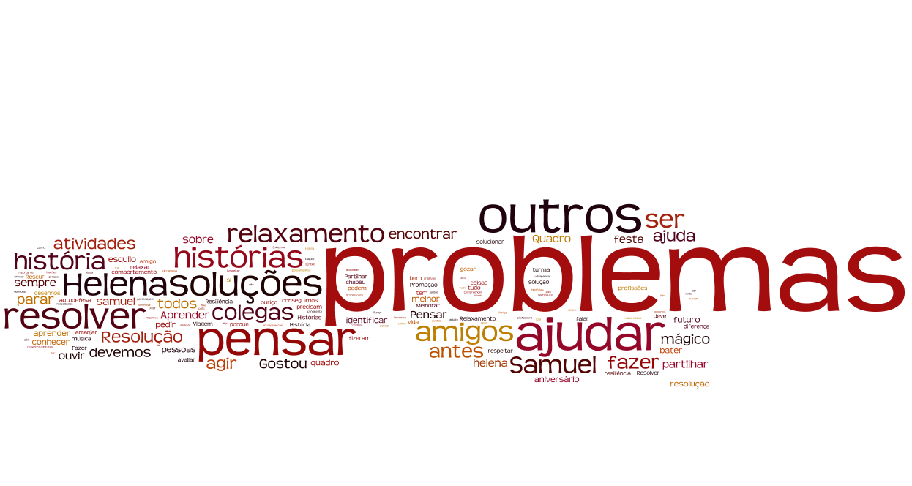
WORD CLOUD

Slide 15
Findings
Focus groups (Pupils)
What I would like to improve…?
• To believe in myself and believe that I can do things, recognize that I can, have more confidence
• Reflect better about the future and my future goals
• Be more altruist and less selfish
• Attitudes and behaviours towards my classmates
• The ability to recognize the problems and solve them, think before act
• The ability to try harder and don’t give up easily
• Learn with my errors and take responsibility for them
• The ability to talk about myself
• Know how to make a difference
• To help others and the ability to ask for help
• The ability to apologize
• Know how to play better with my classmates
• The ability to relax
• To be more independent
• My academic achievement

Slide 16


